Slide 1
A Project Presentation on Airlines Reservation System
Submitted by :
Girban Adhikari
Arjan Sapkota
Subarna Ghimire
Jivan Acharya
Submitted to:
Department of Electronics and Computer Engineering

Slide 2
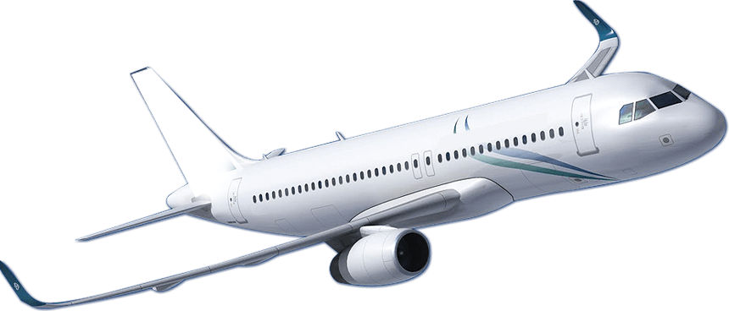
Introduction
Air transportation is one of the most important services to offer both significant social and economic benefits. It is essential for the fast movement of people and cargo shipments around the world .
Airlines reservation system is a computer program designed and developed by using C programming language in order to implement and apply different broad concepts of C language. Airline reservation systems program enables airlines to sell their available seats .
It has fares information, as well as a database of reservations (or passenger name records) and tickets issued .

Slide 3
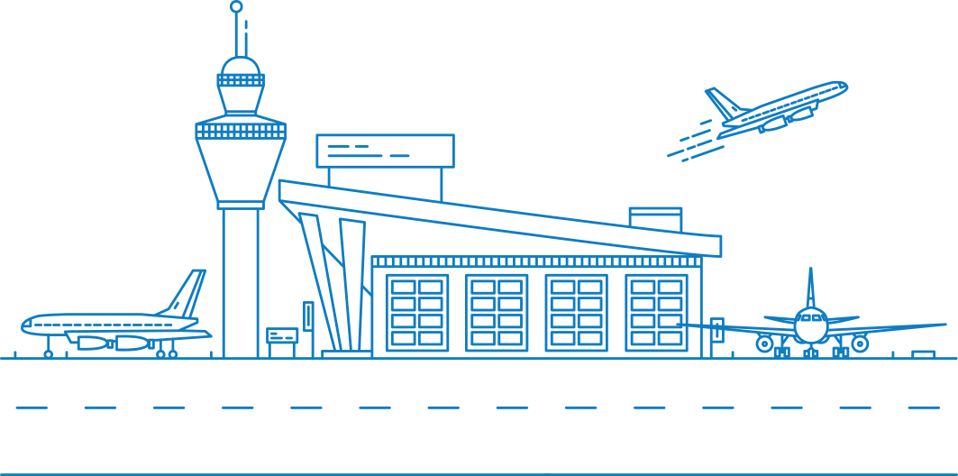
Objectives
The project aims to fulfil the following objectives :
To keep the record of all the travelers that have reserved for flight from the respective aviation or airline
To make the existing workers job easier with the reduction in number of required employees as well as time efficient software for people
To increase the efficiency of reservation of flights as per the requirements of passengers
To enable user to book flight with ease and help the administration in the easy monitoring of flights

Slide 4

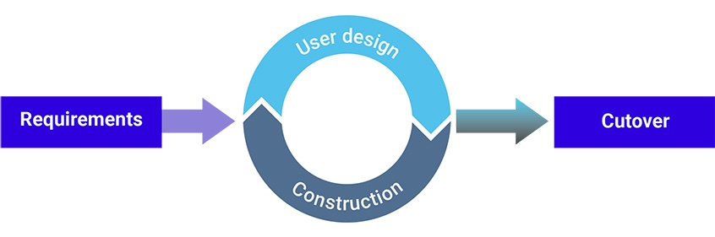
Methodology
Rapid Application Development
The rapid application development method contains four phases: requirements planning, user design, construction, and cutover. The user design and construction phases repeat until the user confirms that the product meets all requirements .
Rapid application development works best for projects that have a clear business goal and a clearly defined user groups, but are not computationally complex. RAD is highly useful for time-sensitive small to medium projects.

Slide 5
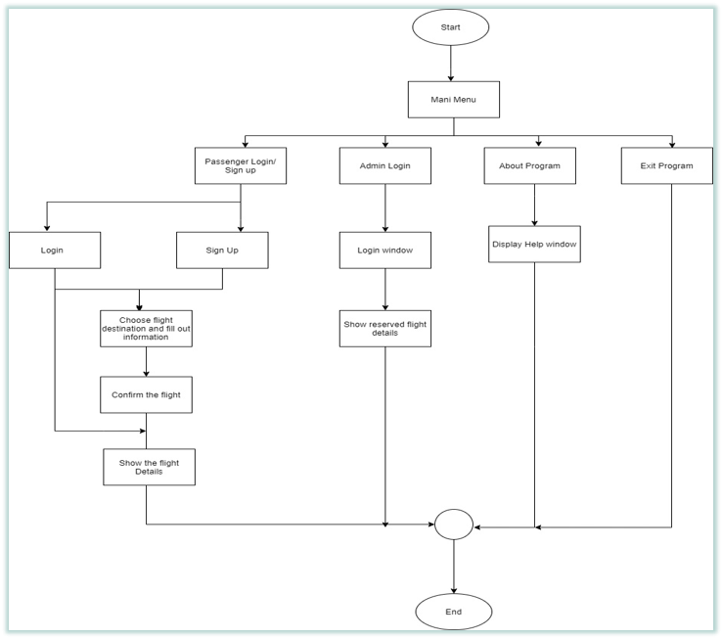
Control Flow
Main Menu

Slide 6
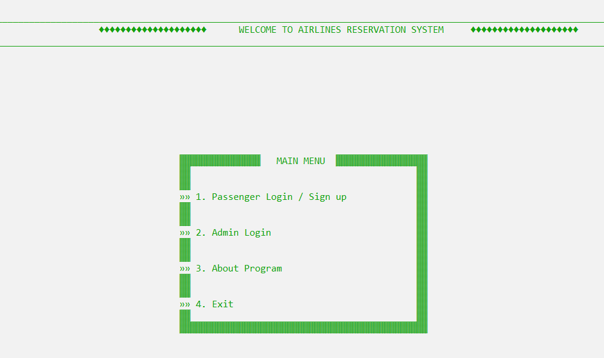
HOME PAGE

Slide 7
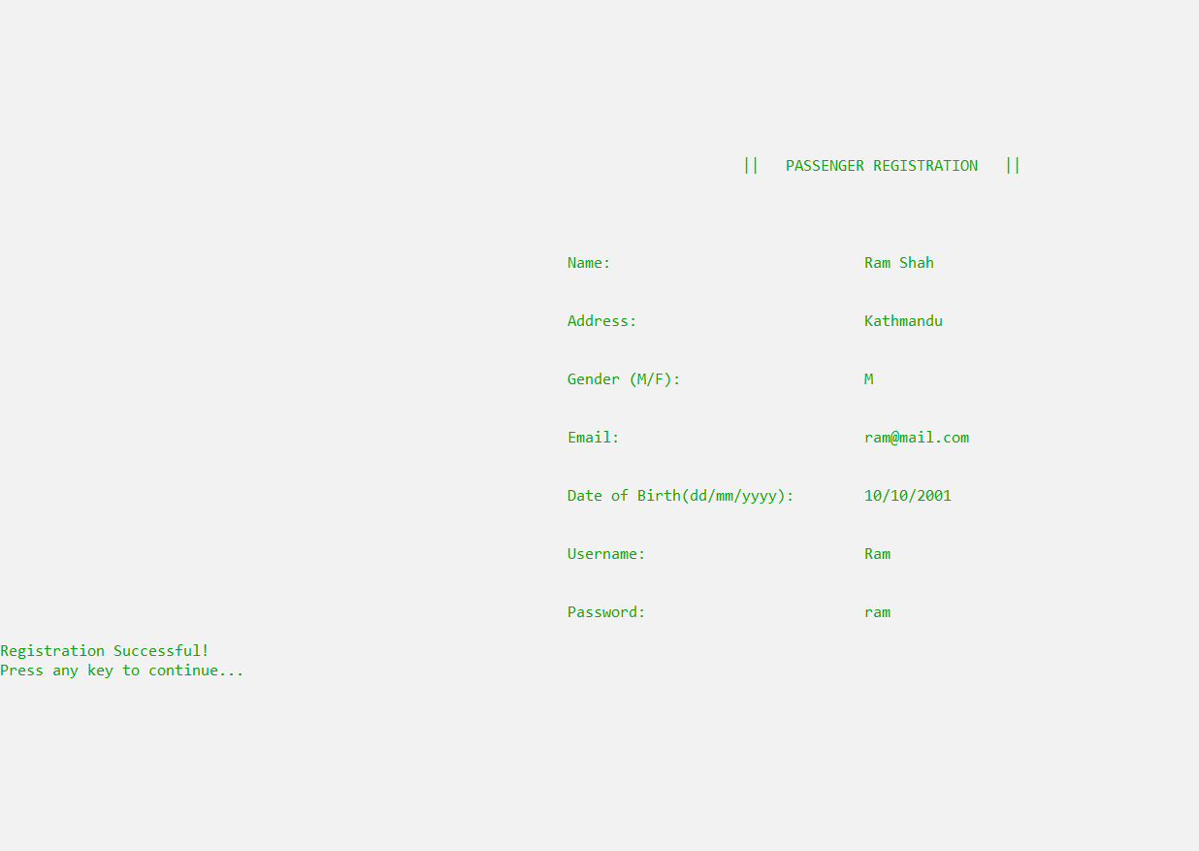
LOGIN /
SIGN UP

Slide 8
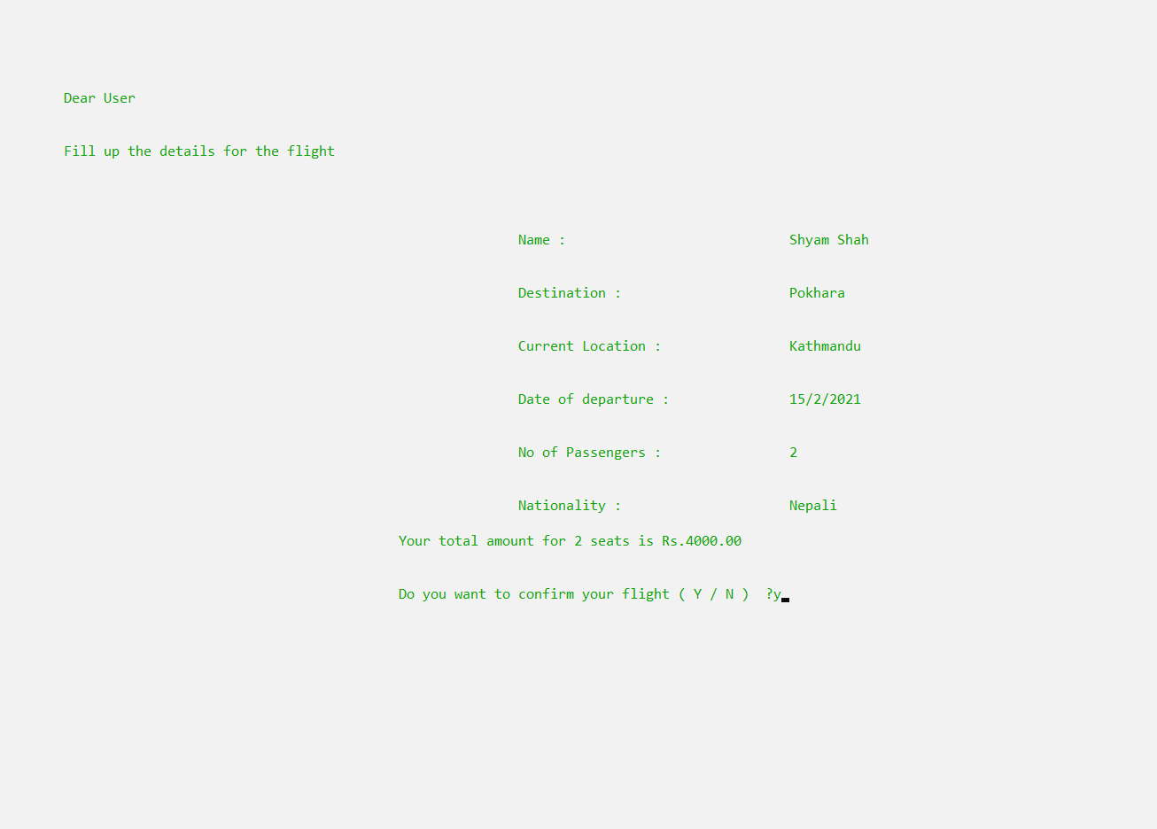
FLIGHT
BOOKING

Slide 9
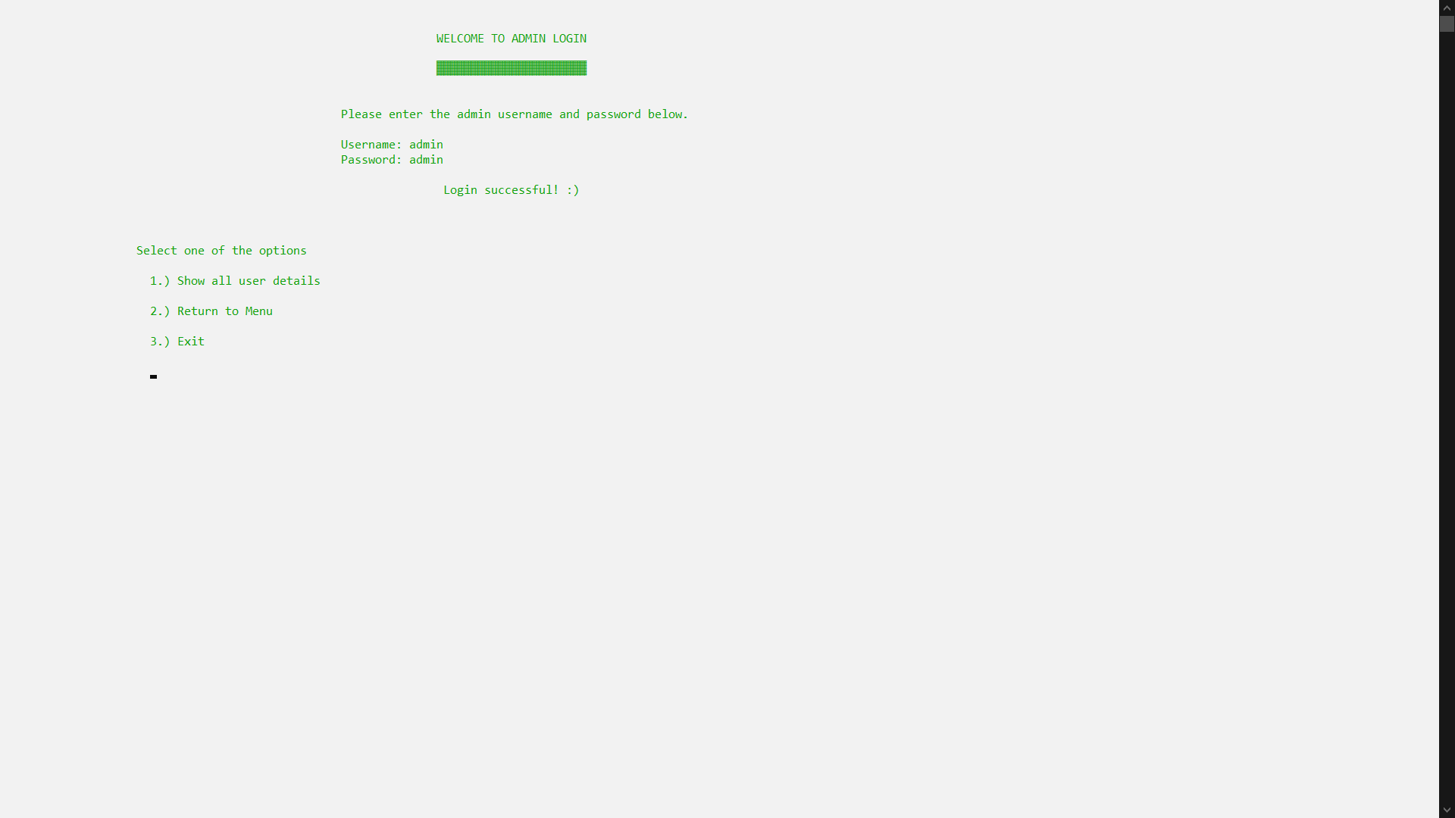
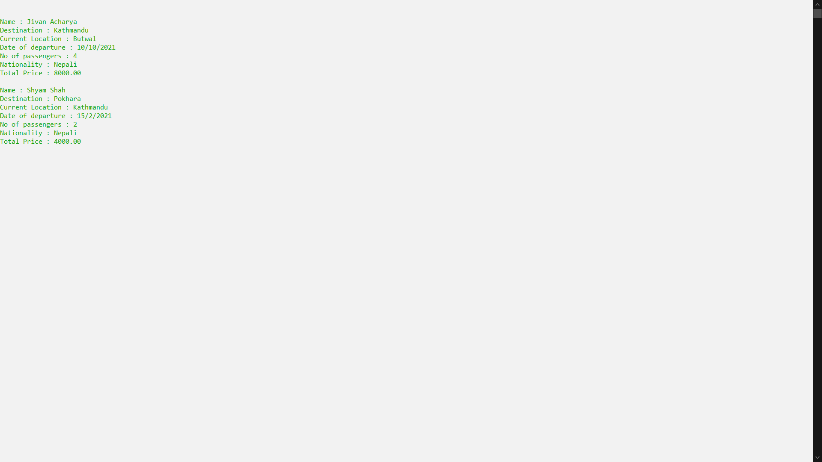
ADMIN
LOGIN

Slide 10

Conclusion
The interface of the program is interactive enough to provide a decent experience for the user while using the program
New users are able to securely register and book flights effortlessly
Admin of the program is able to view all the booked flights of all users
Airlines companies can benefit themselves by using this software
The project explores various features of C-programming languages like functions, loops, structures, file handling etc. to develop and present proficiency of the student developers in c-programming language to create a useful program.

Slide 11
Thanks!
Any questions?

